Slide 1
Intro to Relational Model
— Chapter 2
2021年9月
叶文
yewen@bupt.edu.cn
School of Computer Science (National Pilot Software Engineering School)

Slide 2
Outline
Structure of Relational Databases
Database Schema
Keys
Schema Diagrams
Relational Query Languages
The Relational Algebra
Relational data model, syntax;
relational table structure in database
keys in relational model, semantic
describe multiple tables and their relationships in database
database access by relational algebra operators
Relational data model
data structure (syntax)
integrity constraints (semantic)
constraints on schema attributes, e.g. value domain, type, key
constraints on dependencies among attributes of a schema, e.g. age vs birth-date
constraints on dependencies among attributes of different schemas, normal forms
operations on the model

Slide 3
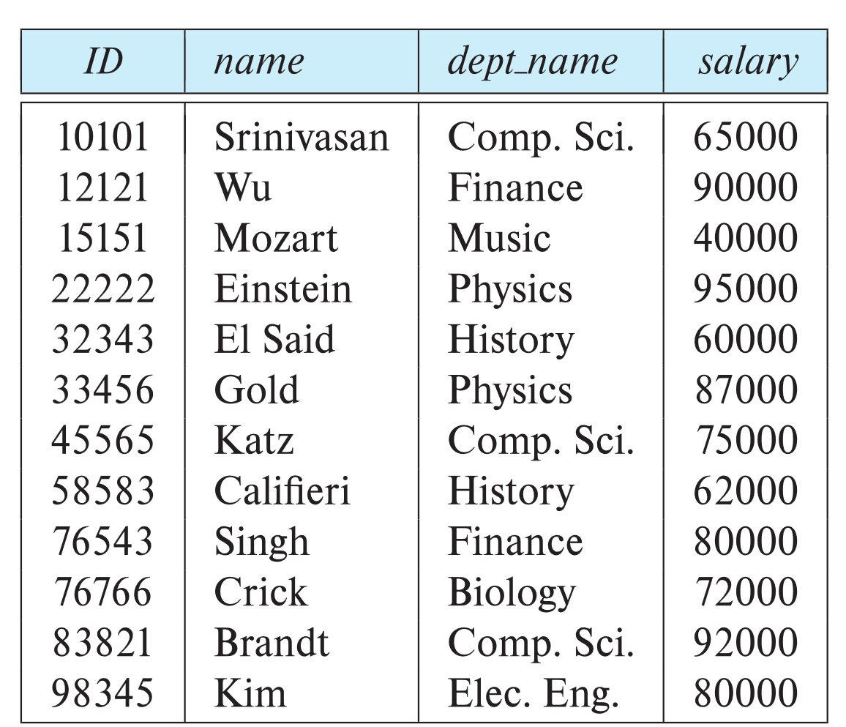
2.1 Structure of Relational Databases
A relational database consists of a collection of tables
Example of a Instructor relation
attributes
(or columns)
tuples
(or rows)

Slide 4
Relational Model Definition
Modeling elements in model
A₁, A₂, …, A_{n} are attributes
Domain of the relation’s attributes D₁, D₂, …. D_{n}
the set of allowed values for each attribute
R = (A₁, A₂, …, A_{n} ) is a relation schema
Example:
instructor = (ID, name, dept_name, salary)
A relation instance r defined over schema R is denoted by r (R)
The current values a relation are specified by a table
An element t of relation r is called a tuple and is represented by a row in a table

Slide 5
Attributes
The set of allowed values for each attribute is called the domain of the attribute
Attribute values are (normally) required to be atomic; that is, indivisible
The special value null is a member of every domain. Indicated that the value is “unknown”
The null value causes complications in the definition of many operations

Slide 6
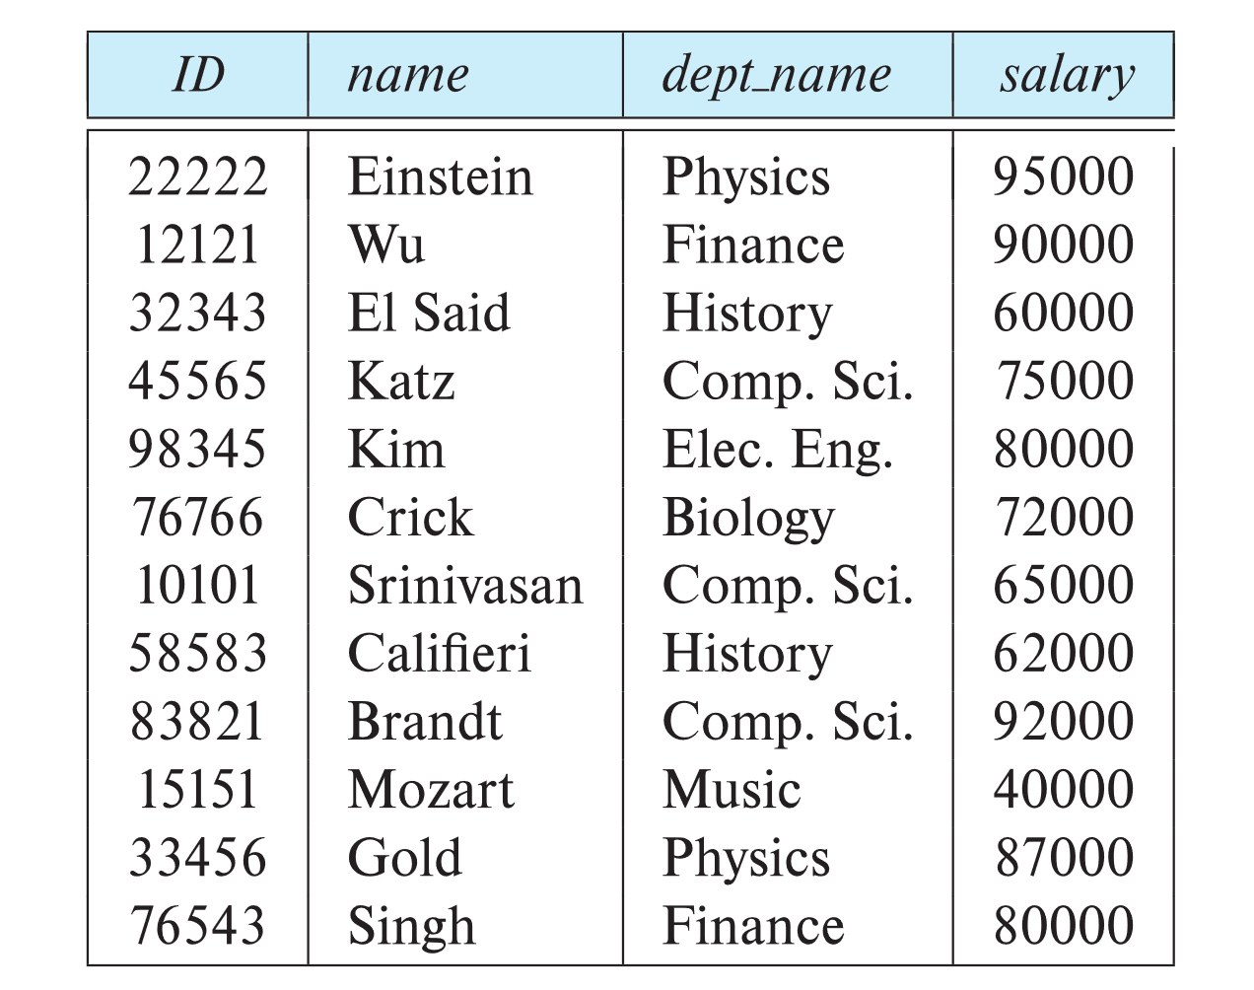
Relations are Unordered
Order of tuples is irrelevant (tuples may be stored in an arbitrary order)
Example: instructor relation with unordered tuples
Attribute orders are also irrelevant
(A₁, A₂, …, A_{n} ) = (A₂, A₁, …, A_{n} )

Slide 7
2.2 Database Schema
Database schema -- is the logical structure of the database.
Database instance -- is a snapshot of the data in the database at a given instant in time.
Example:
schema: instructor (ID, name, dept_name, salary)
Instance:

Slide 8
2.3 Keys
Key : 键，码
A superkey is a set of one or more attributes that, taken collectively, can be used to identify uniquely a tuple in the relation
Def. Given relation schema R(A₁, A₂, …, A_{n}), a subset K of R is the super key of R , if no two distinct tuples in relation r(R) have the same values on all attributes in K
that is, if t₁and t₂ are in r and t₁≠t₂, then t₁.K≠t₂.K
the super key may contain redundant attributes
e.g. {ID} vs {ID, name, dept_name}
K is a candidate key if K is minimal super key
e.g.{ID} is a candidate key for instructor, assuming no two instructors can possibly have the same identifiers

Slide 9
Keys (cont.)
A relation may have several candidate keys
Primary key is a candidate key chosen by the database designer as principal means to identify tuples within a relation
E.g. ID in instructor
Primary key integrity
for a tuple, its values on the primary key are not permitted to be null
Def. Primary attributes(主属性!)
taking the key as a attribute set, the attributes in the candidate keys, i.e. the element of the primary key is called the primary attributes
non-primary attributes(非主属性）
构造关系表时，如果有多个候选键，最好选取数值型 (int, float) 候选键作为主键，便于提高基于主键的查询速度
—不要选字符串型属性，如varchar、datetime, e.g. studentname, instructorName

Slide 10
Foreign key
Describing relationship among relations, a instructor belongs to a department
Def. If X is one or more attributes in relation r₁, and X is also the primary-key of another relation schema r₂
taking Fig.2.9 as case studies
X is called a foreign key from r₁ referencing r₂
由r₁参照/关联r₂的外键
r₁ is called the referencing relation of the foreign key dependency
外键的参照/关联关系
r₂ is called the referenced relation of the foreign key
外键的被参照/关联关系
e.g. X=dept_name in r₁ =instructor-schema (Fig.2.9), r₂ =department-schema, then
dept_name in instructor is a foreign key from instructor referencing department

Slide 11
Foreign key/Referential Integrity
Referential Integrity
values appearing in specified attributes (e.g. dept_name) of any tuples in the referencing relation r₁ (e.g. instructor) must appear in specified attributes of at least one tuples in the referenced relation r₂ (e.g. department)
dept_name in instructor is a foreign key from instructor referencing department
why?
the department that an instructor belongs to in the relation instructor （e.g. Com.Sci）must be a department that has been defined in the relation department corresponds to a tuple (i.e. Com.Sci ) in department

Slide 12
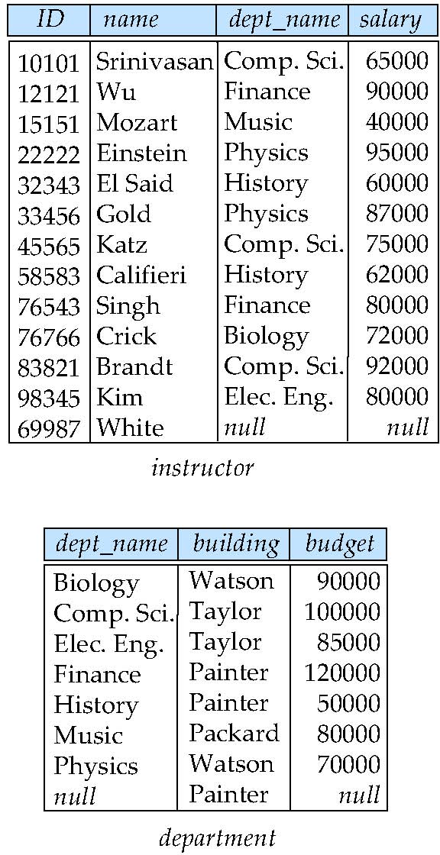
Foreign key/Referential Integrity
注意事项：
如果数据库表之间存在外键关系，导入数据时，先导入被参照关系r₂ (e.g. department) 中的数据，再导入参照关系r₁ (e.g. instructor) 中的数据
e.g. 先定义各个department，再导入属于各个department的instructor的数据
Taylor

Slide 13
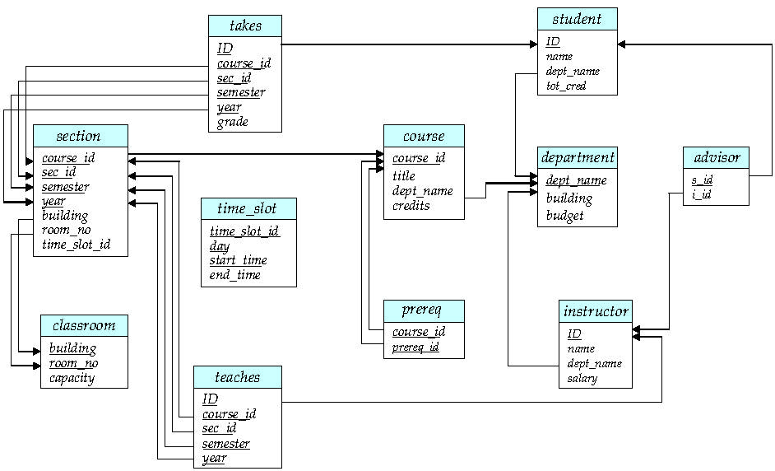
2.4 Schema Diagram for University Database
A database schema, along with primary key and foreign key dependency, can be depicted as the schema diagram
nodes: schema, attributes, primary key
arcs: foreign key dependency, from referencing relation r₁ to referenced relation r₂
r₂
r₁
Fig. 2.9 Schema Diagram

Slide 14
2.5 Relational Query Languages
Procedural versus non-procedural, or declarative
“Pure” languages:
Relational algebra
Tuple relational calculus
Domain relational calculus
The above 3 pure languages are equivalent in computing power
We will concentrate in this chapter on relational algebra
Not Turing-machine equivalent
Consists of 6 basic operations

Slide 15
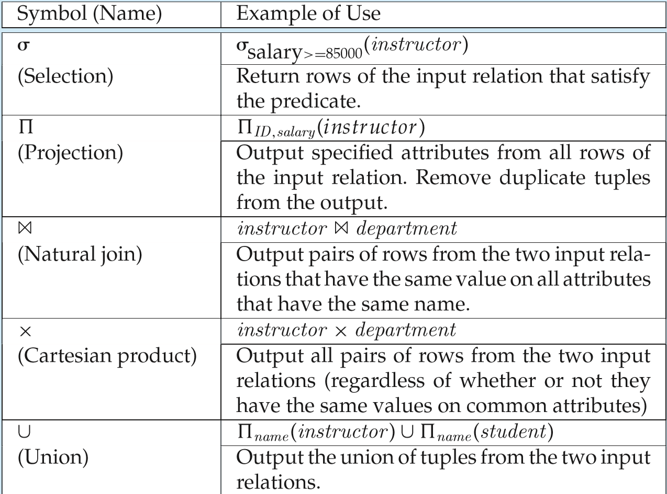
2.6 Relational Algebra
A procedural language consisting of a set of operations/operator that take one or two relations as input and produce a new relation as their result.
Six basic operators
select: σ
project: ∏
union: ∪
set difference: –
Cartesian product: x
rename: ρ

Slide 16
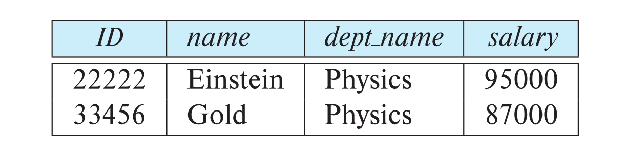
Select Operation
The select operation selects tuples that satisfy a given predicate.
Notation: σ _{p} (r)
p is called the selection predicate
Example: select those tuples of the instructor relation where the instructor is in the “Physics” department.
Query
σ _{dept_name=“Physics”} (instructor)
Result

Slide 17
Select Operation (Cont.)
We allow comparisons using
=, ≠, >, ≥. <. ≤
in the selection predicate.
We can combine several predicates into a larger predicate by using the connectives:
∧ (and), ∨ (or), ¬ (not)
Example: Find the instructors in Physics with a salary greater $90,000, we write:
σ _{dept_name=“Physics”} ∧ _{salary >} _{90,000} (instructor)
The select predicate may include comparisons between two attributes.
Example, find all departments whose name is the same as their building name:
σ _{dept_name=building} (department)

Slide 18
Project Operation
A unary operation that returns its argument relation, with certain attributes left out.
Notation:
∏ _{A1,A2,A3 ….Ak} (r)
where A₁, A₂, …, A_{k} are attribute names and r is a relation name.
The result is defined as the relation of k columns obtained by erasing the columns that are not listed
Duplicate rows removed from result, since relations are sets

Slide 19
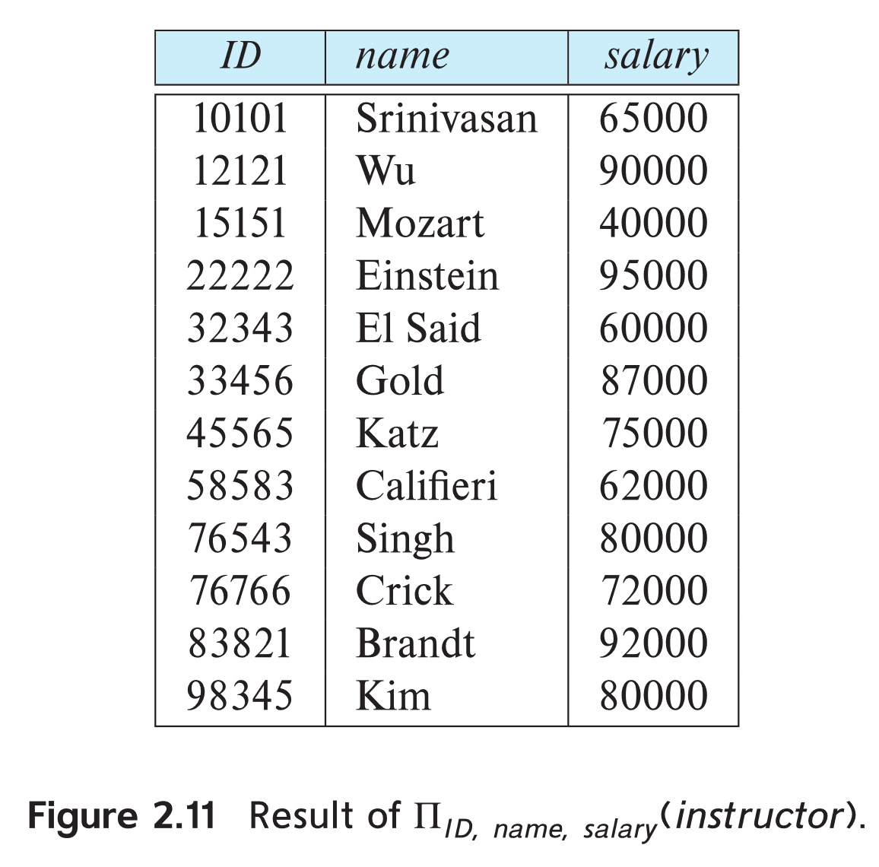
Project Operation Example
Example: eliminate the dept_name attribute of instructor
Query: ∏_{ID, name, salary} (instructor)
Result:

Slide 20
Composition of Relational Operations
The result of a relational-algebra operation is relation and therefore of relational-algebra operations can be composed together into a relational-algebra expression.
Consider the query -- Find the names of all instructors in the Physics department.
∏_{name}(σ _{dept_name} _{=“Physics”} (instructor))
Instead of giving the name of a relation as the argument of the projection operation, we give an expression that evaluates to a relation.

Slide 21
Cartesian-Product Operation
The Cartesian-product operation (denoted by X) allows us to combine information from any two relations.
Example: the Cartesian product of the relations instructor and teaches is written as:
instructor X teaches
We construct a tuple of the result out of each possible pair of tuples: one from the instructor relation and one from the teaches relation (see next slide)
Since the instructor ID appears in both relations we distinguish between these attribute by attaching to the attribute the name of the relation from which the attribute originally came.
instructor.ID
teaches.ID

Slide 22
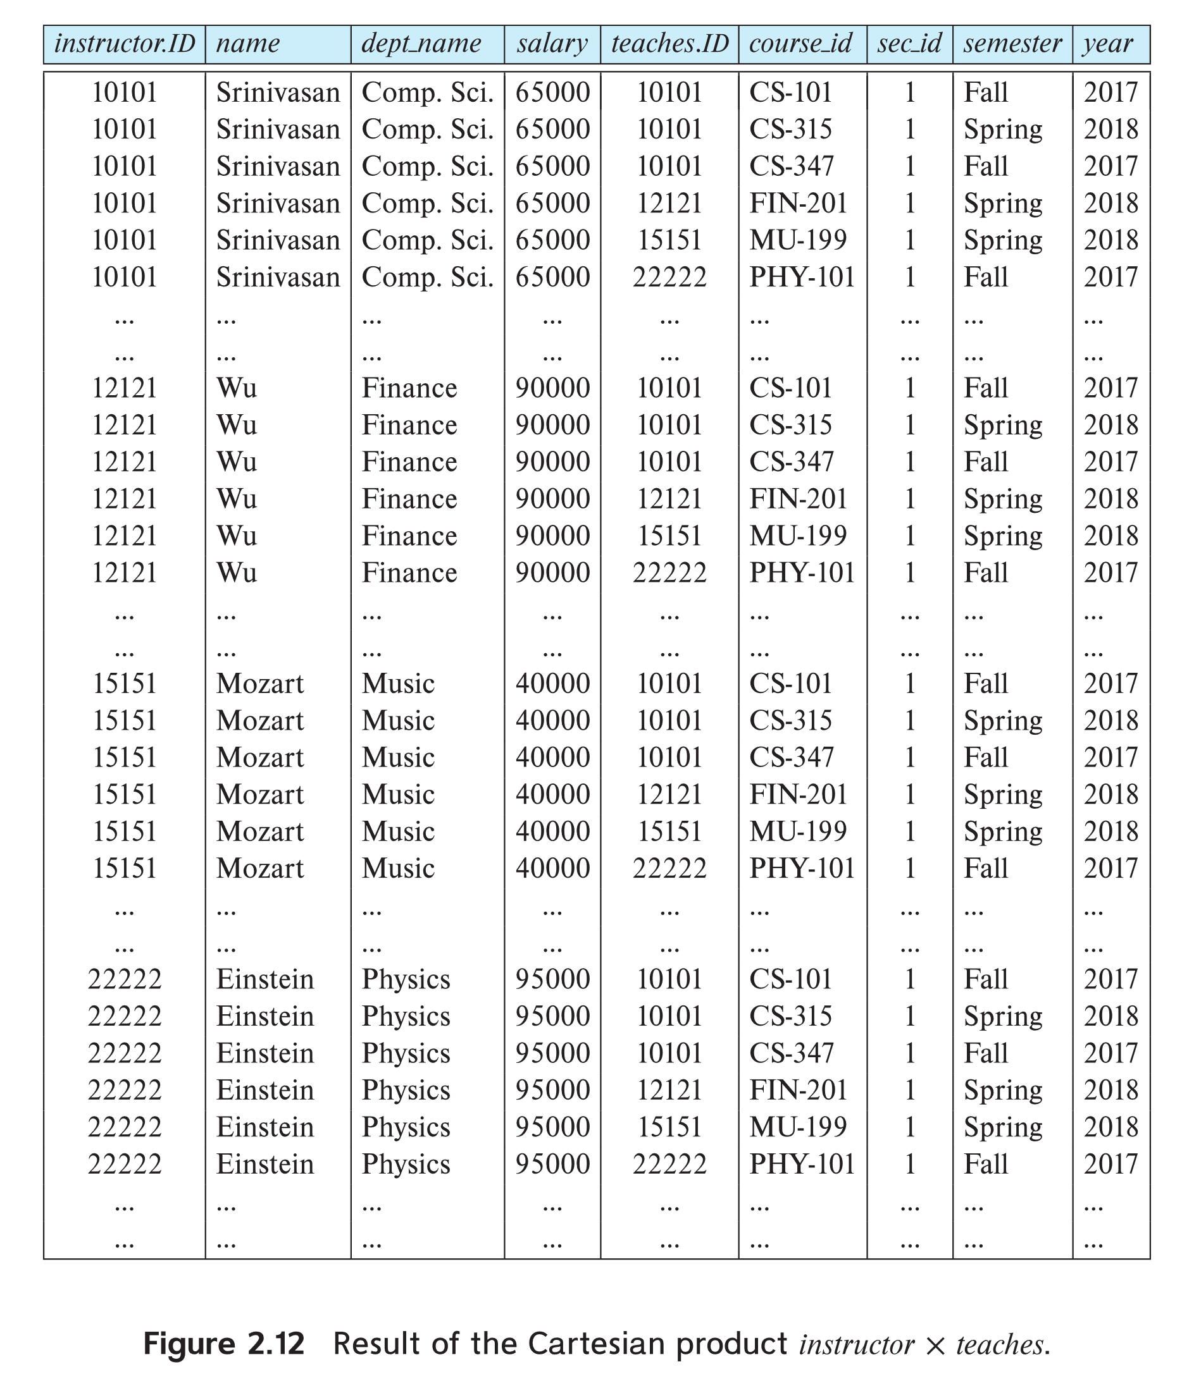
The instructor X teaches table

Slide 23
Join Operation
The Cartesian-Product
instructor X teaches
associates every tuple of instructor with every tuple of teaches.
Most of the resulting rows have information about instructors who did NOT teach a particular course.
To get only those tuples of “instructor X teaches “ that pertain to instructors and the courses that they taught, we write:
σ _{instructor.id = teaches.id} (instructor x teaches ))
We get only those tuples of “instructor X teaches” that pertain to instructors and the courses that they taught.
The result of this expression, shown in the next slide

Slide 24
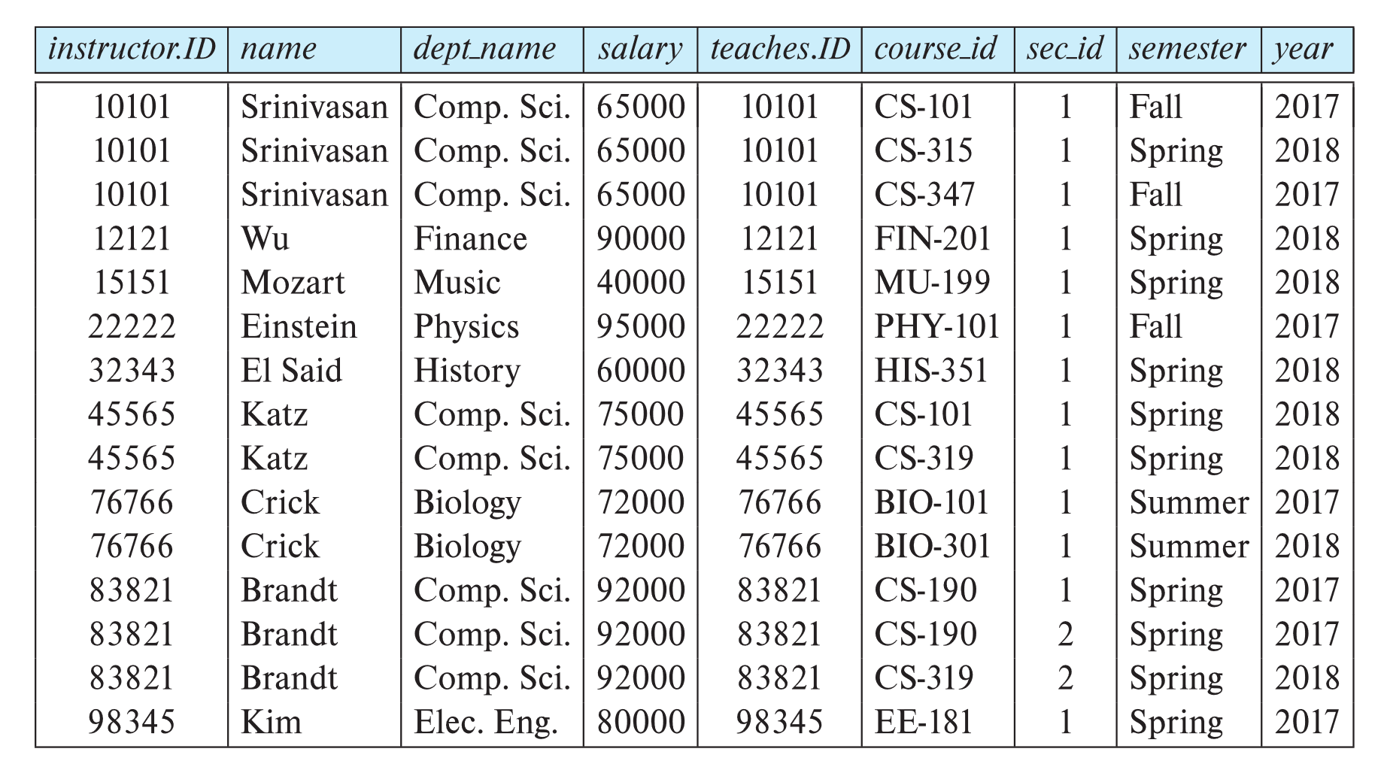
Join Operation (Cont.)
The table corresponding to:
σ _{instructor.id = teaches.id} (instructor x teaches))

Slide 25
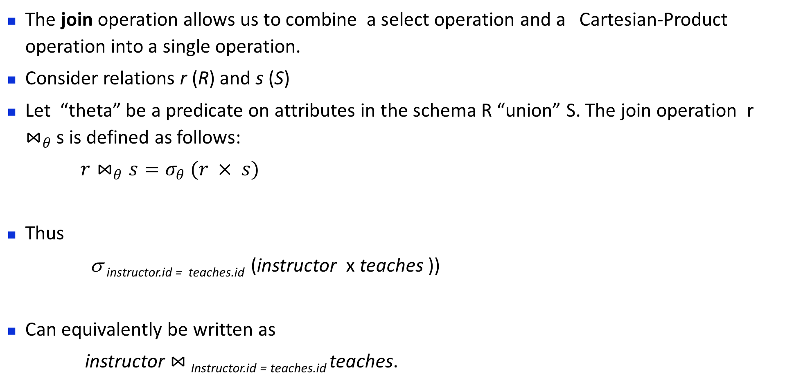
Join Operation (Cont.)
The join operation allows us to combine a select operation and a Cartesian-Product operation into a single operation.
Consider relations r (R) and s (S)
Let “theta” be a predicate on attributes in the schema R “union” S. The join operation r $⋈_{θ}$ s is defined as follows:
$r⋈_{θ}s=σ_{θ} (r × s)$
Thus
σ _{instructor.id = teaches.id} (instructor x teaches ))
Can equivalently be written as
instructor $⋈_{ }$_{Instructor.id = teaches.id} teaches.

Slide 26
Union Operation
The union operation allows us to combine two relations
Notation: r ∪ s
For r ∪ s to be valid.
1. r, s must have the same arity (same number of attributes)
2. The attribute domains must be compatible (example: 2nd
column of r deals with the same type of values as does the
2nd column of s)
Example: to find all courses taught in the Fall 2017 semester, or in the Spring 2018 semester, or in both ∏_{course_id} (σ _{semester=“Fall” Λ year=2017} (section)) ∪ ∏_{course_id} (σ _{semester=“Spring” Λ year=2018} (section))

Slide 27
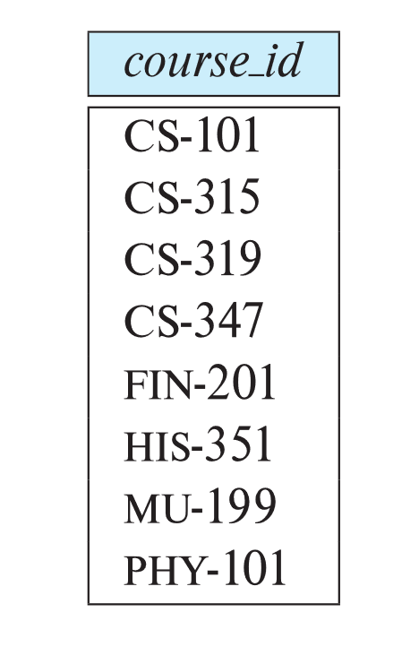
Union Operation (Cont.)
Result of: ∏_{course_id} (σ _{semester=“Fall” Λ year=2017} (section)) ∪ ∏_{course_id} (σ _{semester=“Spring” Λ year=2018} (section))

Slide 28
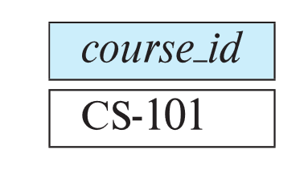
Set-Intersection Operation
The set-intersection operation allows us to find tuples that are in both the input relations.
Notation: r ∩ s
Assume:
r, s have the same arity
attributes of r and s are compatible
Example: Find the set of all courses taught in both the Fall 2017 and the Spring 2018 semesters.
∏_{course_id} (σ _{semester=“Fall” Λ year=2017} (section)) ∩ ∏_{course_id} (σ _{semester=“Spring” Λ year=2018} (section))
Result

Slide 29

Set Difference Operation
The set-difference operation allows us to find tuples that are in one relation but are not in another.
Notation r – s
Set differences must be taken between compatible relations.
r and s must have the same arity
attribute domains of r and s must be compatible
Example: to find all courses taught in the Fall 2017 semester, but not in the Spring 2018 semester ∏_{course_id} (σ _{semester=“Fall” Λ year=2017} (section)) − ∏_{course_id} (σ _{semester=“Spring” Λ year=2018} (section))

Slide 30
The Assignment Operation
It is convenient at times to write a relational-algebra expression by assigning parts of it to temporary relation variables.
The assignment operation is denoted by ← and works like assignment in a programming language.
Example: Find all instructor in the “Physics” and Music department. Physics ← σ _{dept_name=“Physics”} (instructor)
Music ← σ _{dept_name=“Music”} (instructor)
Physics ∪ Music
With the assignment operation, a query can be written as a sequential program consisting of a series of assignments followed by an expression whose value is displayed as the result of the query.

Slide 31
The Rename Operation
The results of relational-algebra expressions do not have a name that we can use to refer to them. The rename operator, ρ , is provided for that purpose
The expression:
ρ_{x} (E)
returns the result of expression E under the name x
Another form of the rename operation:
ρ_{x(A1,A2, .. An)} (E)

Slide 32
Equivalent Queries
There is more than one way to write a query in relational algebra.
Example: Find information about courses taught by instructors in the Physics department with salary greater than 90,000
Query 1
σ _{dept_name=“Physics”} ∧ _{salary > 90,000} (instructor)
Query 2
σ _{dept_name=“Physics”} (σ _{salary > 90.000} (instructor))
The two queries are not identical; they are, however, equivalent -- they give the same result on any database.

Slide 33
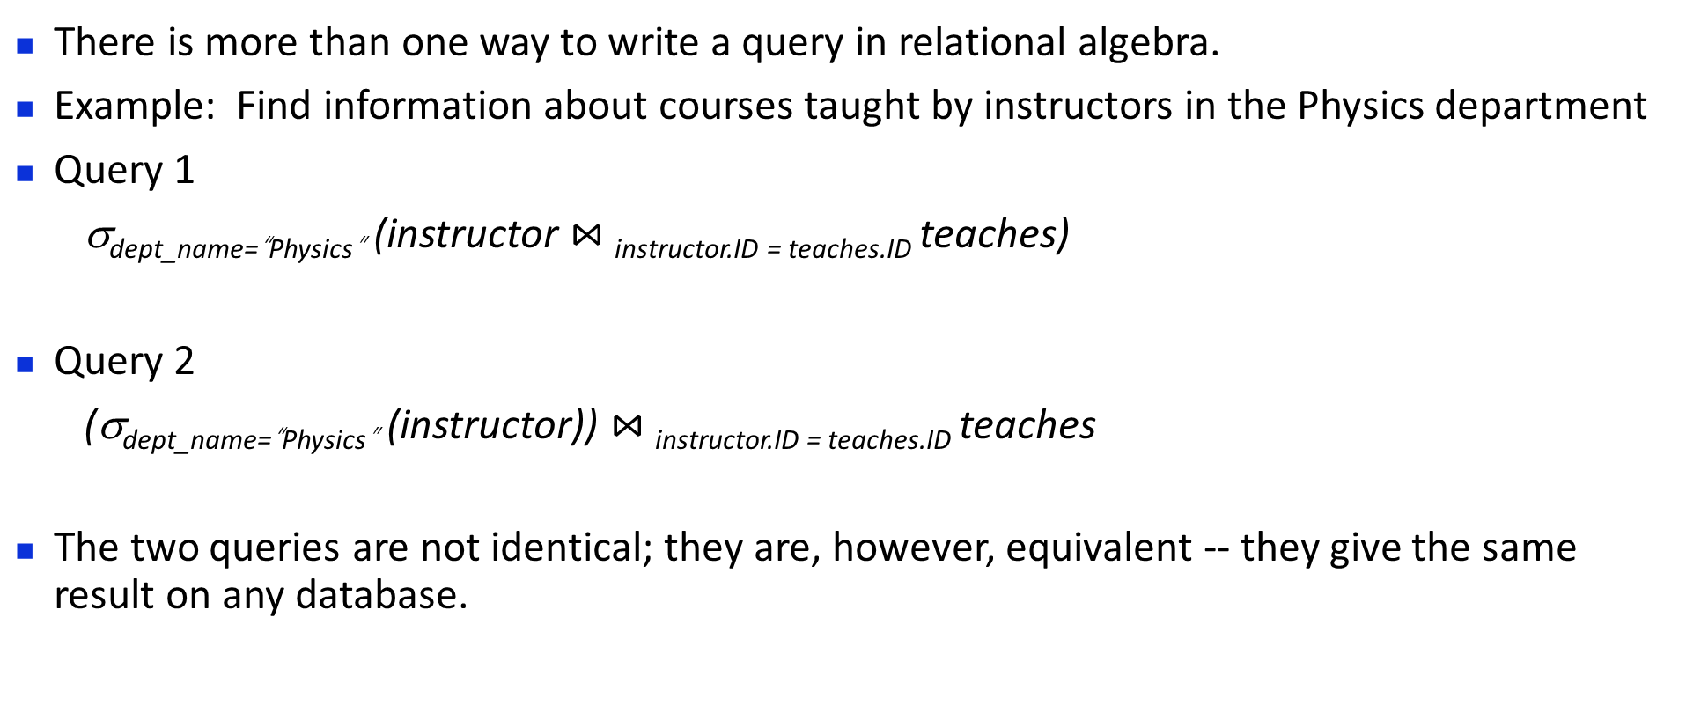
Equivalent Queries
There is more than one way to write a query in relational algebra.
Example: Find information about courses taught by instructors in the Physics department
Query 1
σ_{dept_name=“Physics”} (instructor $⋈_{ }$_{instructor.ID = teaches.ID} teaches)
Query 2
(σ_{dept_name=“Physics”} (instructor)) $⋈_{ }$_{instructor.ID = teaches.ID} teaches
The two queries are not identical; they are, however, equivalent -- they give the same result on any database.
查询结果相同，执行效率/成本不同→查询优化

Slide 34

Thanks for your attention

